Slide 1



NeCTAR eResearch Tools
Cloud-based Bioinformatics Tools Project
Steering Committee Meeting 11 June 2012

Slide 2
Agenda
Introductions
Cloud-based Bioinformatics Tools project overview
NeCTAR project deliverables and milestones overview (incl. finances)
NeCTAR Reporting
Reporting Schedule
Project status relative to milestones and budget
Project Risks and Issues
External Dependencies
Other Business
Current System Demonstration (highlights) - optional

Slide 3
Steering Committee Membership
Winthrop Professor Eric Moses, Director of the Centre for Genetic Epidemiology and Biostatistics, UWA
Dr Nik Zeps, Research Group Leader, St John of God Health Care
Professor John Hopper, Professor & Director (Research), Centre for Molecular, Environmental, Genetic and Analytic (MEGA) Epidemiology, Melbourne School of Population Health
David Goldstein, Clinical Oncological Society of Australia – Nik to confirm who will be attending
Professor Lin Fritschi, Western Australian Institute for Medical Research
Dr Nigel Ward, Deputy Director at NeCTAR, University of Melbourne, Data Management Coordinator at eResearch group, School of ITEE, The University of Queensland

Slide 4
Project Overview - Background
The objective of The Ark project is to provide a suite of secure, open source, integrated web-based tools that incorporate the majority of the functionality required to conduct a complex study or clinical trial.
The Ark project was established within the Centre for Genetic Epidemiology & Biostatistics at the University of Western Australia in late 2009.
The Ark software is currently in production on NeCTAR NSP hardware

Slide 5
Project Overview - Background
The Ark currently incorporates the following functionality:
Create and configure a study;
Define users and manage their roles and access permissions;
Define and manage a research participant pool;
Define and manage the collection of phenotypic research data;
Dynamically generate Electronic Data Capture (EDC) forms for collecting textual research data;
Manage physical biospecimens and the associated data; and
Generate reports.

Slide 6
Project Overview – NeCTAR Project
The NeCTAR Cloud-based Bioinformatics Tool proposal was developed to implement additional functionality required by our collaborators and to deploy this to the cloud for access by other researchers.
Integration with the AAF authentication services;
An integrated invoicing and billing module;
A data extraction for analysis module;
A pedigree (family) data management and visualisation module;
Enhanced reporting functionality;
Registry Management functionality for managing participant registries, such as the Australian Twin Registry; and
A genotypic data management module.

Slide 7
Project Overview
Total project budget: $614,490
Total NeCTAR contribution: $290,598
Total co-investment: $323,892

Slide 8
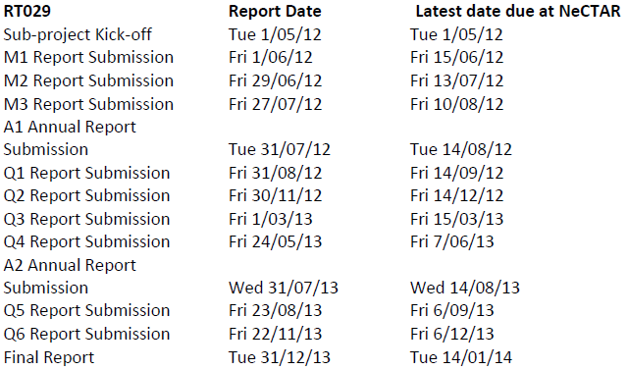
NeCTAR Reporting - Schedule

Slide 9
NeCTAR Reporting – Budget & Timeline
Milestone Title | Comments/Status | Target Milestone Date | NeCTAR (EIF) funds (‘000) | Co-investment (budgeted contribution value) (‘000)
Sub-contract signed (Linked to Funding Milestone 1) | Complete |  |  | 20 (cash)
Funding Milestone 1 | Complete |  | 52
Established Support Tools & Processes (Linked to Funding Milestone 2) | Complete | 15-May-12 |  | 1
Project Initiation complete (Linked to Funding Milestone 2) | Drafted Communications Plan – awaiting feedback | 1-Jul-12
Integrated existing application with AAF Authentication Services (Linked to Funding Milestone 2) | Complete | 14-Jun-12 |  | 3
Funding Milestone 2 |  | 14-Jun-12 | 52
Integrated Invoicing & Billing Complete (Linked to Funding Milestone 3) | Commenced detailed requirements analysis | 15-Aug-12 |  | 40
Initial Production Research Cloud Deployed (Linked to Funding Milestone 3) | Commenced development | 15-Aug-12 |  | 9
Funding Milestone 3 |  | 15-Aug-12 | 52
Implemented Data Extraction for Analysis Module (Linked to Funding Milestone 4) |  | 30-Sep-12 |  | 2
Implemented Pedigree Storage & Visualisation Module (Linked to Funding Milestone 4) |  | 15-Oct-12 |  | 12
Funding Milestone 4 |  | 15-Nov-12 | 52
Enhanced Data Linkage & Reporting Module Complete (Linked to Funding Milestone 5) |  | 15-Dec-12 |  | 7
Implemented Registry Management Module (Linked to Funding Milestone 5) |  | 15-Dec-12 |  | 21
Integrated Genotypic Data Management Capability (Linked to Funding Milestone 5) |  | 28-Feb-13 |  | 20
Funding Milestone 5 | Note that all development should be completed by 28 Feb, 2013 | 28-Feb-13 | 52
Final Admin Closure (Funding Milestone 6) | Post-implementation Review (PIR) conducted and sent to NeCTAR. | 30-Sep-13 | 29
Operations to June 2014 | Service Levels met and reported to NeCTAR as defined. |  |  | 189

Slide 10
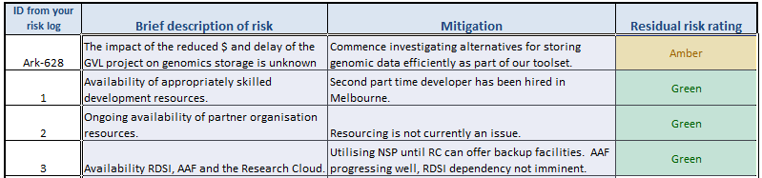
NeCTAR Reporting – Risks & Issues

Slide 11
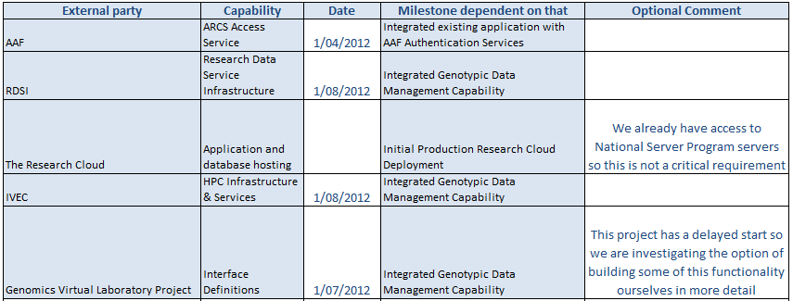
NeCTAR Reporting – Dependencies

Slide 12
Other Business
We have been invited to participate in a NeCTAR proposal for a Proteomics Virtual Laboratory
Date for next meeting – propose prior to the Q1 Report Submission which is due at NeCTAR on 14/09/2012

Slide 13
Release Management
Release 1.1.0 - AAF Integration & Ongoing Updates - 8/06/2012
Release 1.1.1 - Ongoing Updates - 30/06/2012
Release 1.1.2 - Integrated Billing & Invoicing - 15/08/2012
Release 1.1.3 - Production Research Deployment - 15/08/2012
Release 1.1.4 - Data Extraction for Analysis – 30/09/2012

Slide 14
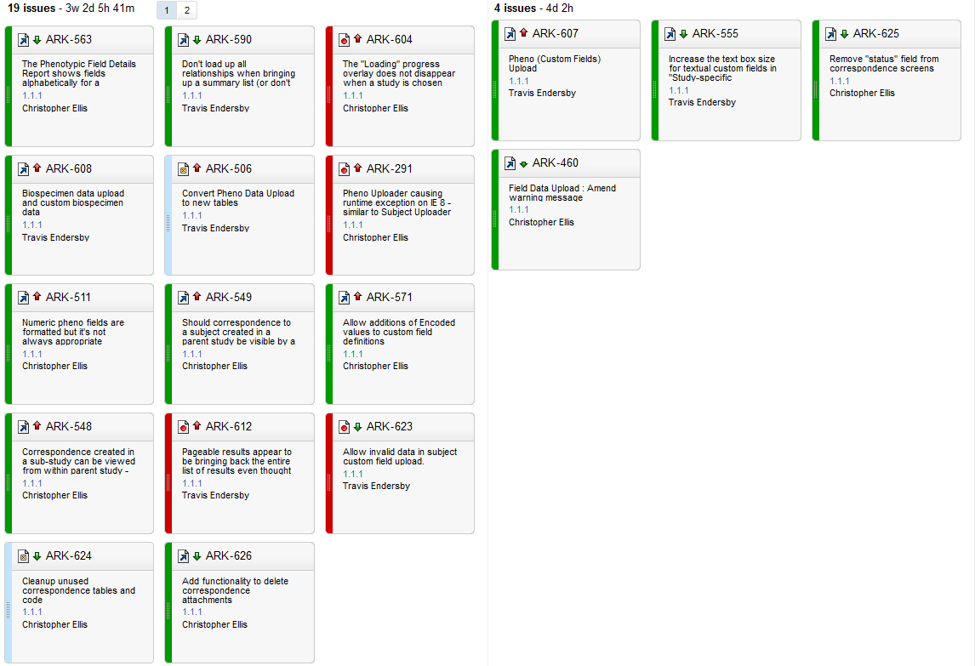
Release 1.1.1 – Ongoing Updates

Slide 15
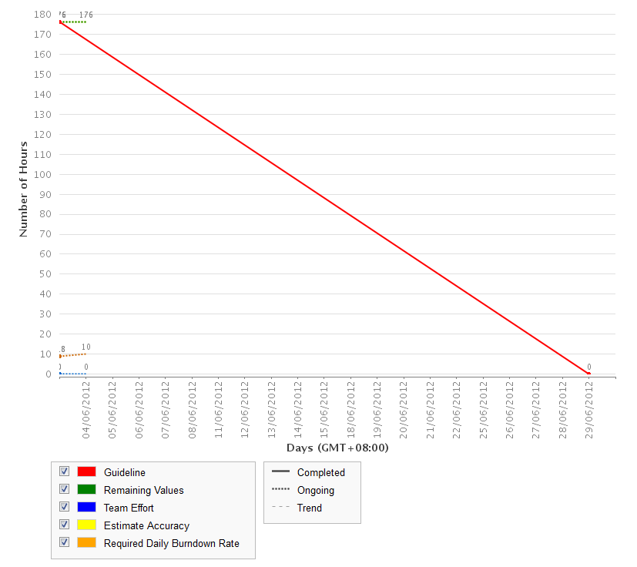
Burn Down chart – Release 1.1.1

